Slide 1
Embedded Firmware
Coding Your Future

Slide 2

Agenda
Why are you here?
Why am I here?
What you will learn
Tools Needed
Class Schedule
Homework
Next Steps

Slide 3

Why Are You Here
What do you want to learn?
What do you think learning that will provide?
Why do you think that?

Slide 4

Why am I here
I like helping people learn
I want to share my years of knowledge so you do not make the same mistakes I did.

Slide 5

Prerequisites
Distorted Sense of humor
Lots of Insanity
Ability to think
Desire to learn and suffer
Need for frustration

Slide 6

What you will learn
More about how microcontrollers work than you ever wanted to know
How a microcontroller starts running code
Assembly programming
What is a hex file, how about a binary file
How to program a microcontroller
How to debug a microcontroller
C programming, even some C++ programming

Slide 7

What you will Not learn
You will not learn how to deal with frustration
You will get lots of opportunity to practice
You will not learn how to do the right things
You will learn the right things to do
You will not learn how to be happy
You will learn every day not programming are happier.
Your will not learn how to be a programmer
Who would want that?

Slide 8

Expectations
If you make it to the end of the class you will…
Curse all the code you ever see…
Curse all the code you ever write..
Never ever want to program again.
Consider doing something easy as a career, like rocket science.
Will reevaluate your life choices that brought you to this class.

Slide 9

Class Schedule
The classes will meet once or twice a week, outside of working hours
Currently thought is to do an early morning class
You will hate the class, you will hate the time of the class, you will hate the results of the class.
There will be homework, and it will take several hours to do.
Matt will be available for office hours to help with homework…

Slide 10
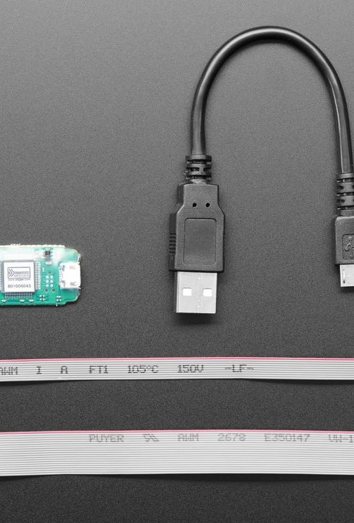
Tools Needed
JLINK Programmer
https://www.adafruit.com/product/3571
$20 $60

Slide 11
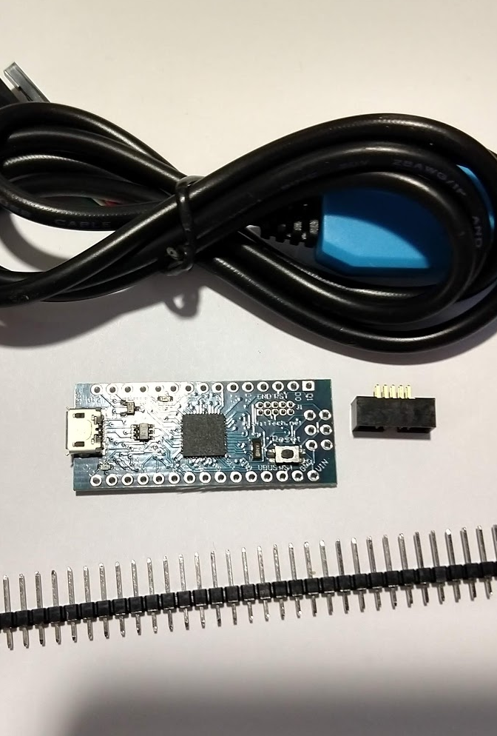
Hardware
ATSAMDxx board
USB Serial Adapter
Connectors

Slide 12
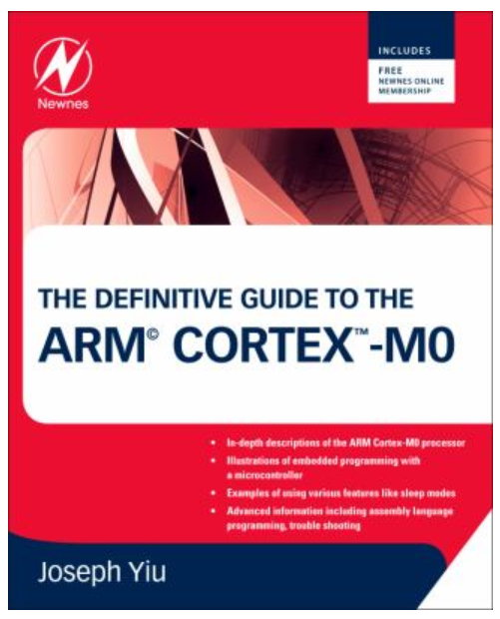
Books
The Definitive Guide to the ARM Cortex-M0
The Definitive Guide to ARM® Cortex®-M3 and Cortex®-M4 Processors

Slide 13

Homework
Order JLINK Programmer
Install JLINK software
Read Datasheets (ATSAM, and Cortex M0) about vector/exception table
Order books if you want them

Slide 14

Next Steps
Wait for next class

